Slide 1
TATA MOTORS PARIVAR YUVA PRATIBHA scholarship

Slide 2
TATA MOTORS PARIVAR YUVA PRATIBHA SCHOLARSHIP
Scholarship amount
Eligibility
Employee must have completed minimum 2 years of continues service with current TATA MOTORS Dealership
Scheme Period
Application form submission:- 15th August, 2017 – 25th September, 2017
Permanent Employee of dealerships
Child must secure a minimum aggregate of Marks as below
Class V Rs 4000
Class VIII Rs 6000
Class X Rs 8000
Class XII Rs 10000
Child who have passed Class V, VIII, X, XII Standard class in the academic year 2016-17
Scholarship Announcement in September, 2017
Class V & VIII – 85% Marks or equivalent.
Class X & XII – 90% Marks or equivalent.

Slide 3
Selection Process
TATA dealership Employee need to download the application form from the website mentioned & fill the same providing their & children’s details
(www.yuvapratibha.tatamotors.com)
Forms received at the program center will be collated and verified
Any discrepancy in the documents will be communicated back to Dealership HR.
Dealership HR need to revert back within the mentioned timeframe on that discrepancy. Failing which the application will be rejected
Felicitation program to handover the Certificate & Scholarship Cheque will be plan in the month of Sept’17
List of the Children selected for the scholarship scheme will be informed in the month of Sept’17
Filled Forms with attested copies of required documents needs to be couriered to the program center at the mentioned address.
(The form has to be verified and stamped by the HR Manager of Dealership)
*
Dealership HR Manager will act as Single point of Contact (SPOC) with the Program Centre.
All Employees need to submit filled form along with required documents to their Dealership HR.
Dealership HR needs to verify, Club the applications and courier the same at Program center address.
Kindly refer the Last submission date mentioned on the application form.

Slide 4
Terms & Conditions
Applications forms need to be submitted from 15th August, 2017 – 25th September, 2017
Scholarships will be awarded to children who have passed class V, VIII, X, XII in the academic year 2016-17.
The Scholarship is available for children of permanent employees of dealership who have completed minimum 2 years of continuous service with the Current TATA Motors Dealership.
Minimum Percentage eligibility :
Class V & VIII – 85% Marks or equivalent.
Class X & XII – 90% Marks or equivalent.
Incomplete forms will be rejected.
Scholarship Cheque will be issued only on Child’s Name. If the child does not have a bank account, Please open Child Individual Bank account.

Slide 5
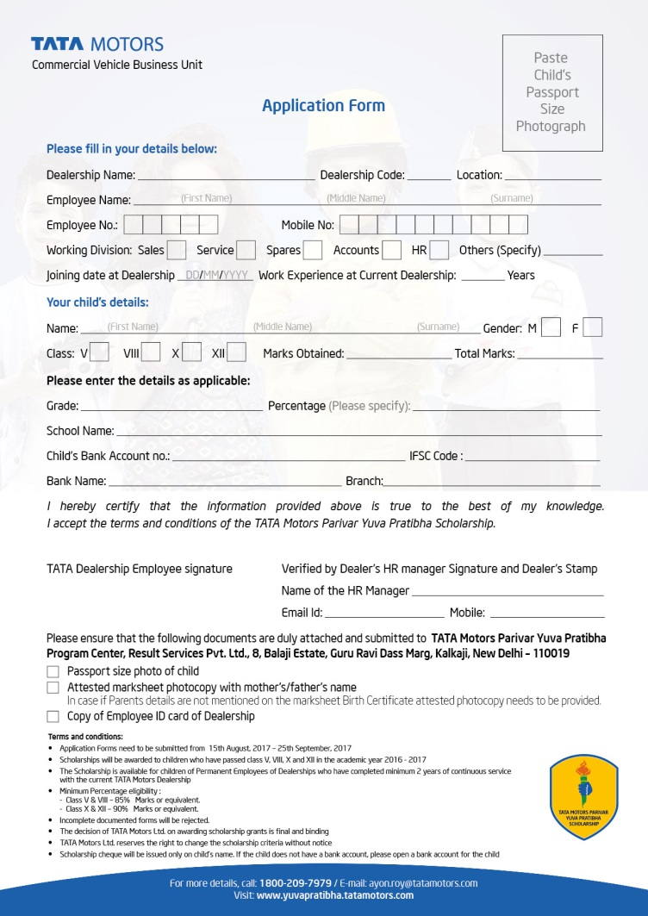
Application form
Download the application form from the website
www.yuvapratibha.tatamotors.com

Slide 6
Contact Us
For more details,
Call 1800-209-7979
For any unresolved query after speaking to your Dealership HR Managers & above motioned Call center.
Kindly Email to:-
ayon.roy@tatamotors.com

Slide 7
Grades/ GPA Conversion
Grades and GPA of children will be converted to % as per the conversion table below
For example:
Grades | GPA | % Conversion | Our Conversion For Scholarship
A+(A1) | 10 | 90%-100% | 95%
A(A2) | 9 | 81%-89% | 85%
B+(B1) | 8 | 71%-80% | 75%
B(B2) | 7 | 61%-70% | 65%
C+(C1) | 6 | 51%-60% | 55%
C(C2) | 5 | 41%-50% | 45%
D(E1) | 4 | 31%-40% | 35%
F(E2) | C | Below 30% | 25%
Minimum % Eligibility
Subjects | Grades
English | A
Math | A
Hindi | B+
Science | B+
History | C
Geography | B
Physical Education | C+
Total | B
% Conversion
85%
85%
75%
75%
45%
65%
55%
69%

Slide 8
THANK YOU

